Slide 1
Abdelrahman Saad Aya Tamer Omar Nasser

Slide 2
Agenda
Dataset Overview
Exploratory Analysis: Key Questions
Outlier

Slide 3
Exploratory Analysis: Key Questions

Slide 4
Outlier
In these two steps we cleaned the dataset by removing rows with unrealistic trip values
First, we kept only trips with a `distance` between **0.5 km and 100 km**, dropping rides that were either too short to be real or implausibly long.
Then, we filtered `fare_amount` to keep only fares between **$0.50 and $300**, eliminating entries that were clearly errors or outliers (like zero-fare trips or extremely high charges).
This ensures the remaining data reflects realistic trips for more accurate analysis and modeling.

Slide 5
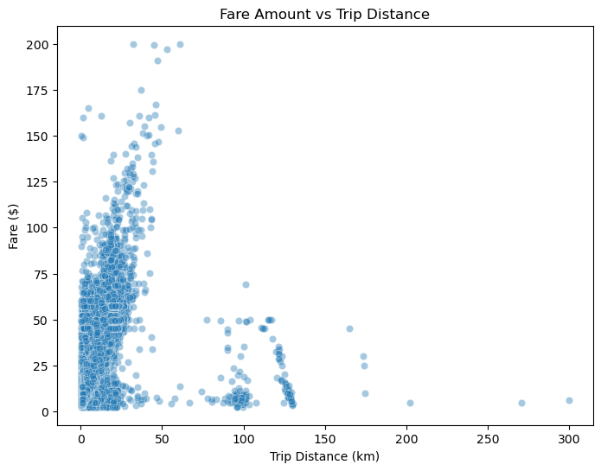
How does trip distance affect the fare amount?

Slide 6
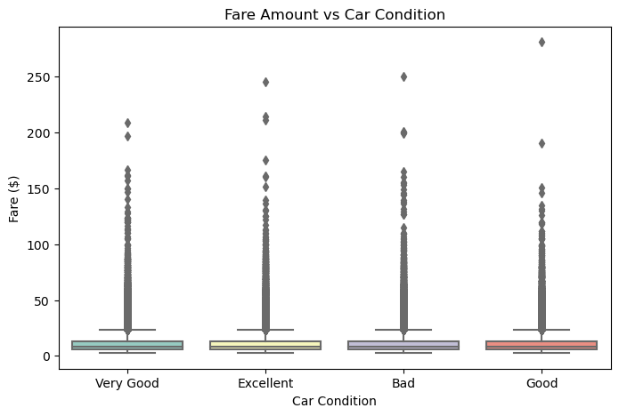
How does car condition affect the fare amount?

Slide 7
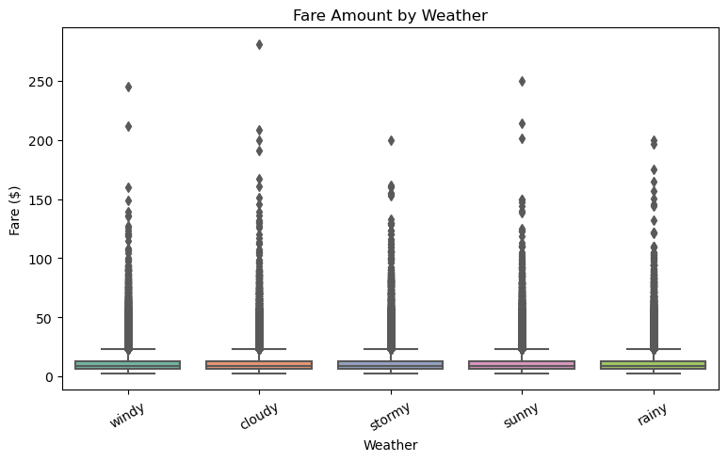
How does weather affect fare amount?

Slide 8
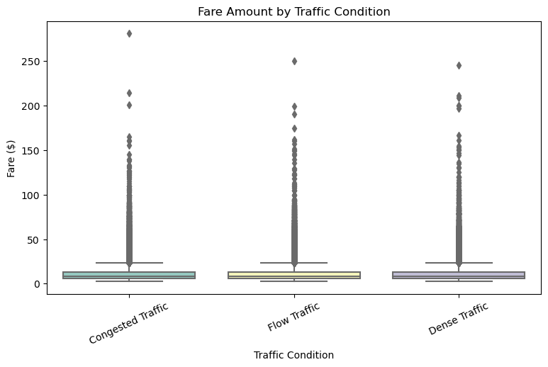
How does traffic condition affect fare amount?

Slide 9
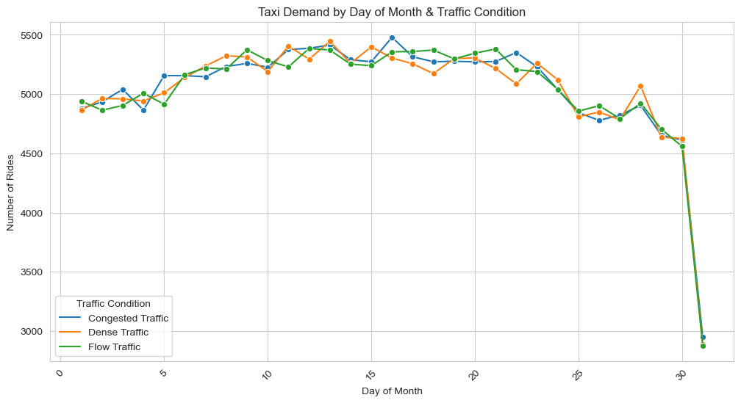
How does taxi demand vary across days of the month under different traffic conditions?

Slide 10
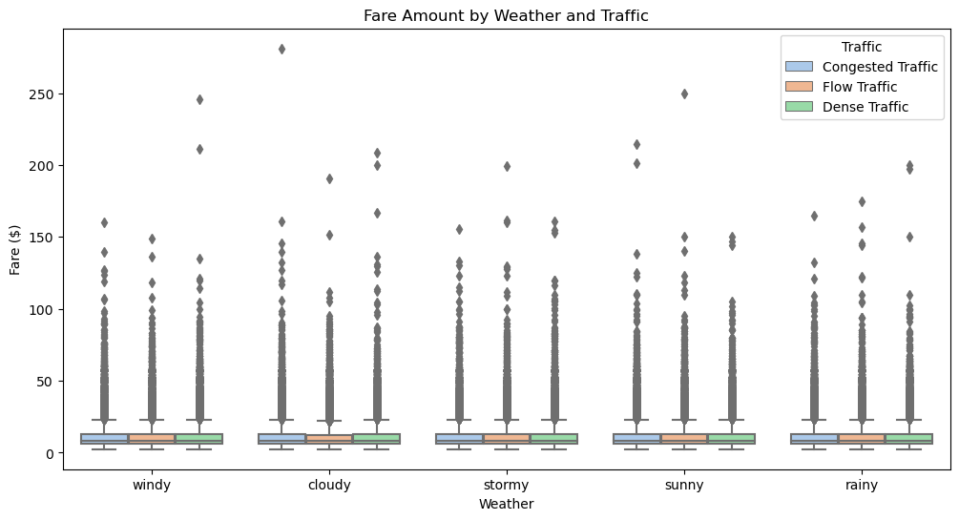
How do fare amounts vary across different weather conditions, and how is this relationship affected by traffic conditions?

Slide 11
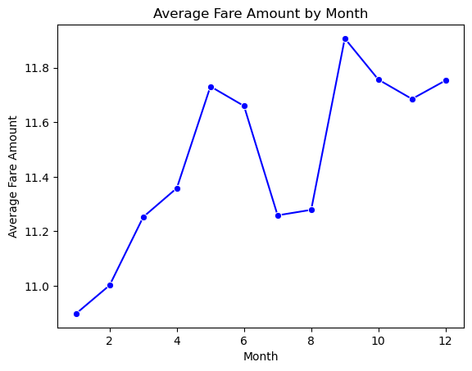
How does the average taxi fare amount vary across different months of the year?

Slide 12
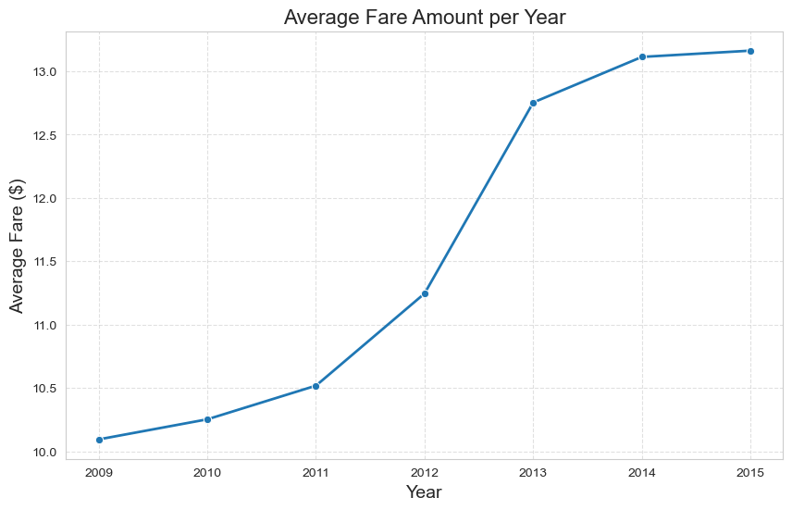
How has the average taxi fare amount changed over the years?

Slide 13
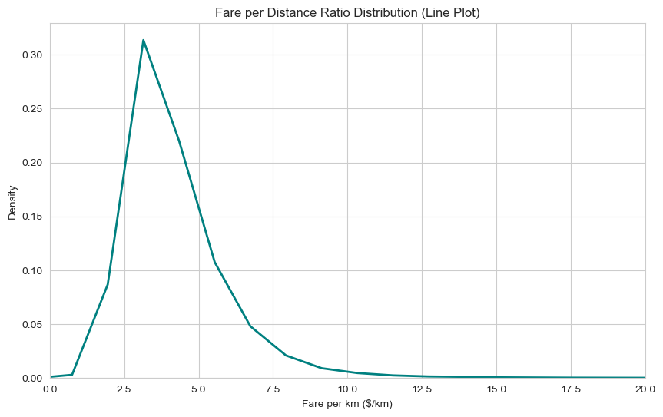
What does the distribution of fare per kilometer tell us about taxi pricing efficiency?

Slide 14
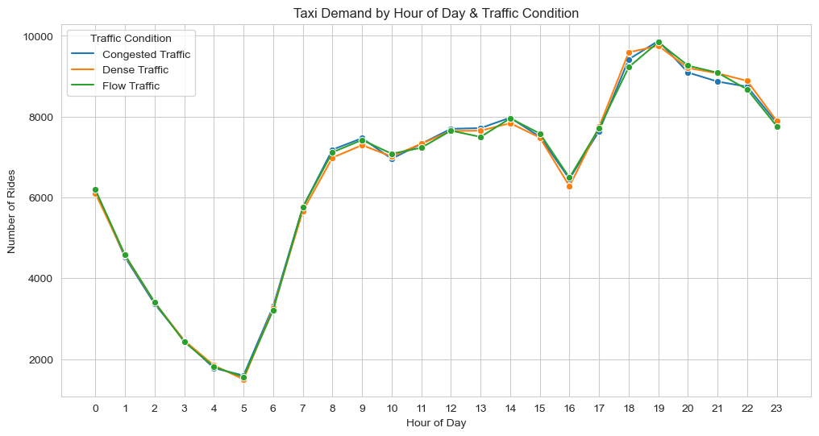
How does taxi demand vary by hour of the day under different traffic conditions?

Slide 15
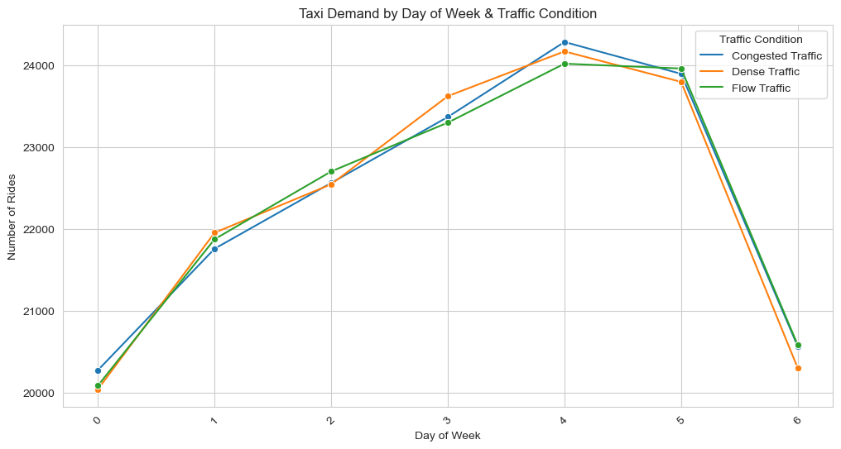
How does taxi demand differ across weekdays under various traffic conditions?

Slide 16
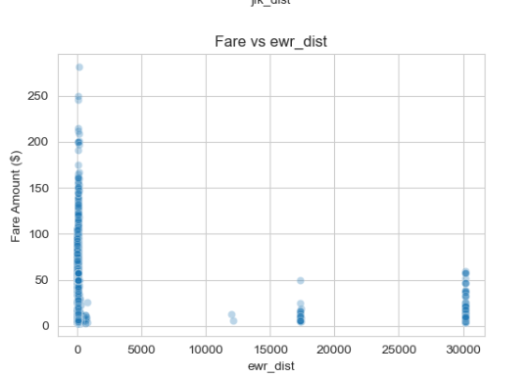
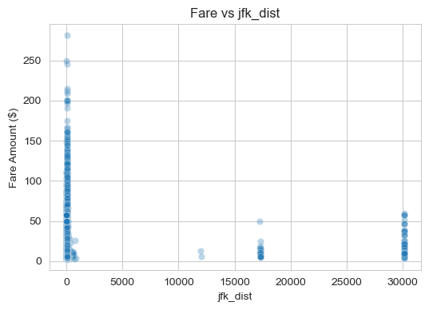
What is the relationship between taxi fare amount and the distance to major landmarks or airports?

Slide 17
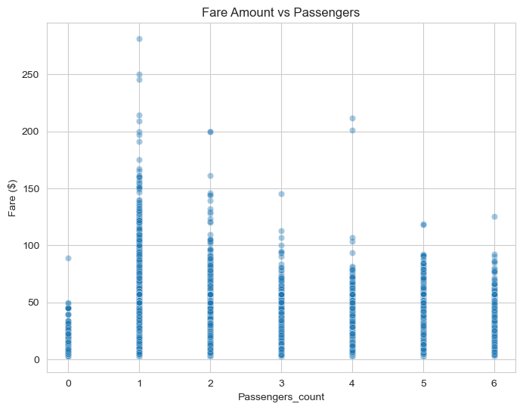
How does the number of passengers in a trip influence the fare amount?

Slide 18
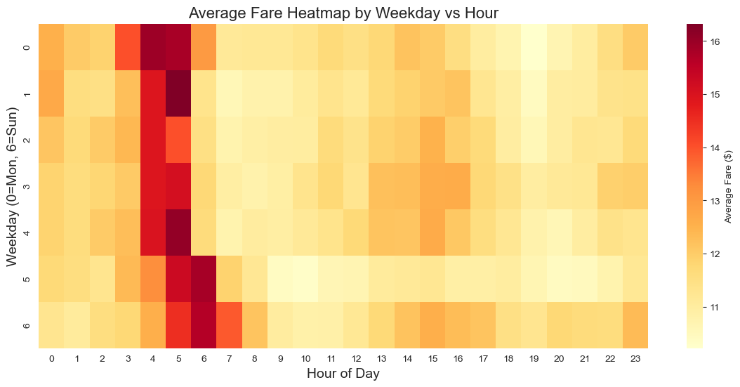
How do average taxi fares vary across weekdays and hours of the day?

Slide 19
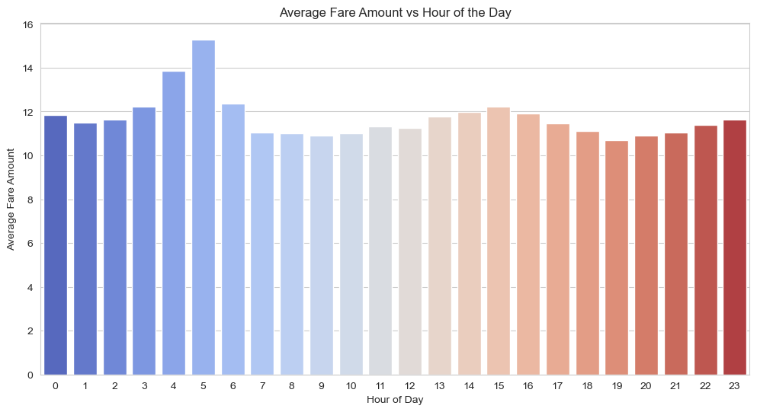
How does the average taxi fare amount change across different hours of the day?

Slide 20
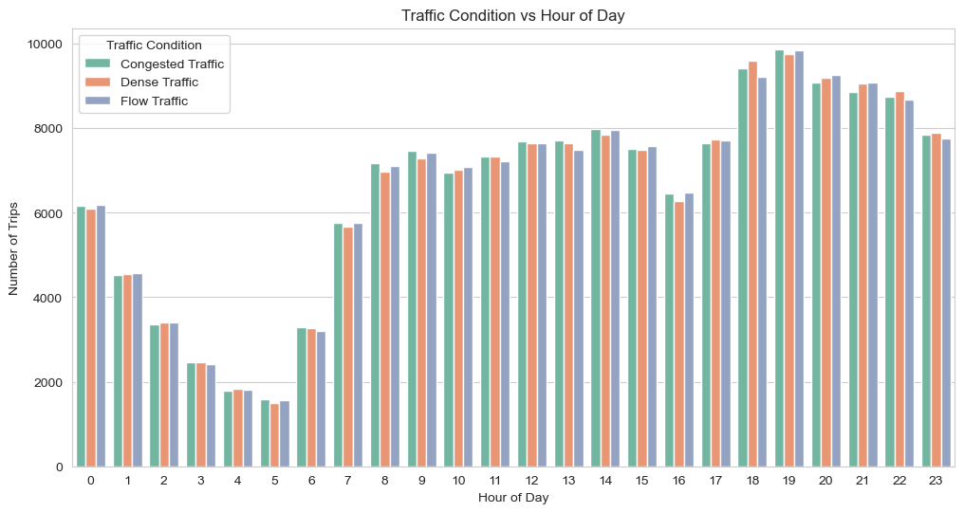
How do traffic conditions affect taxi trip demand across different hours of the day?

Slide 21
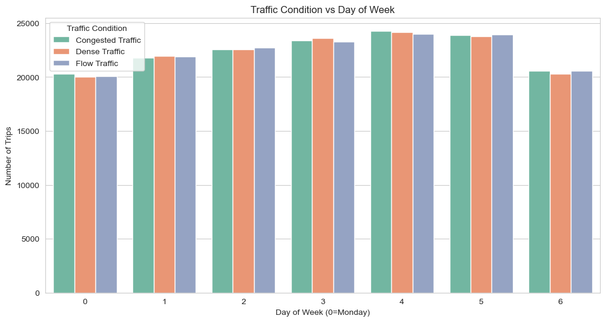
How do traffic conditions influence taxi demand across different weekdays?

Slide 22
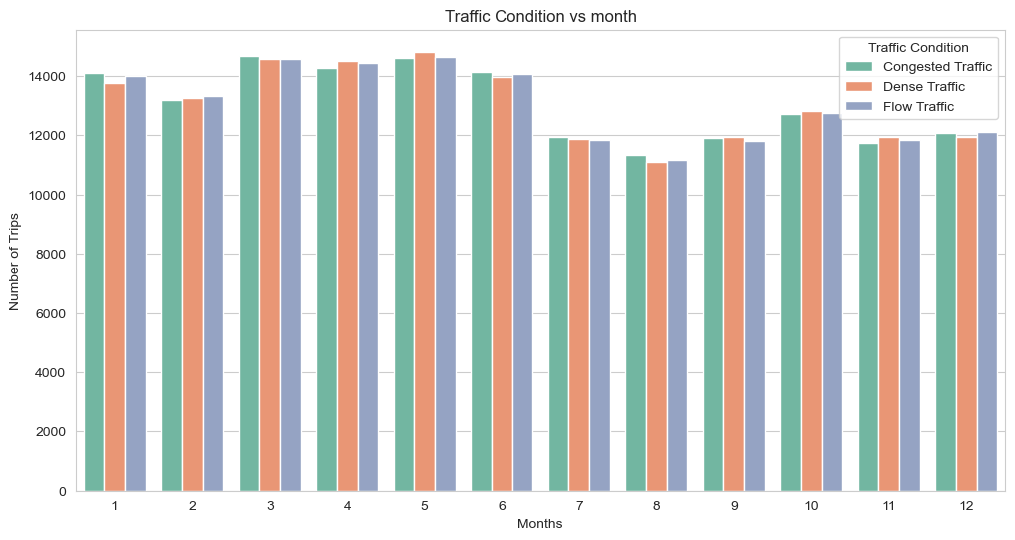
How do traffic conditions vary across different months of the year?

Slide 23
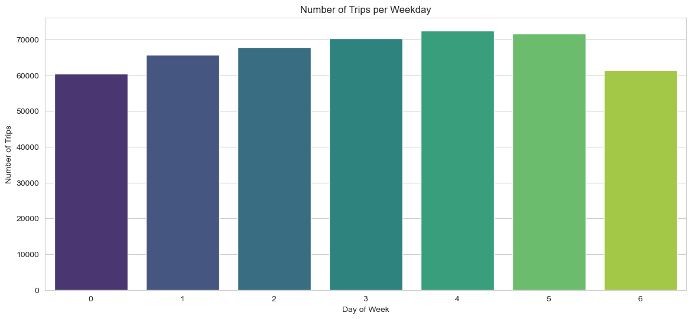
Which weekday records the highest number of taxi trips?

Slide 24
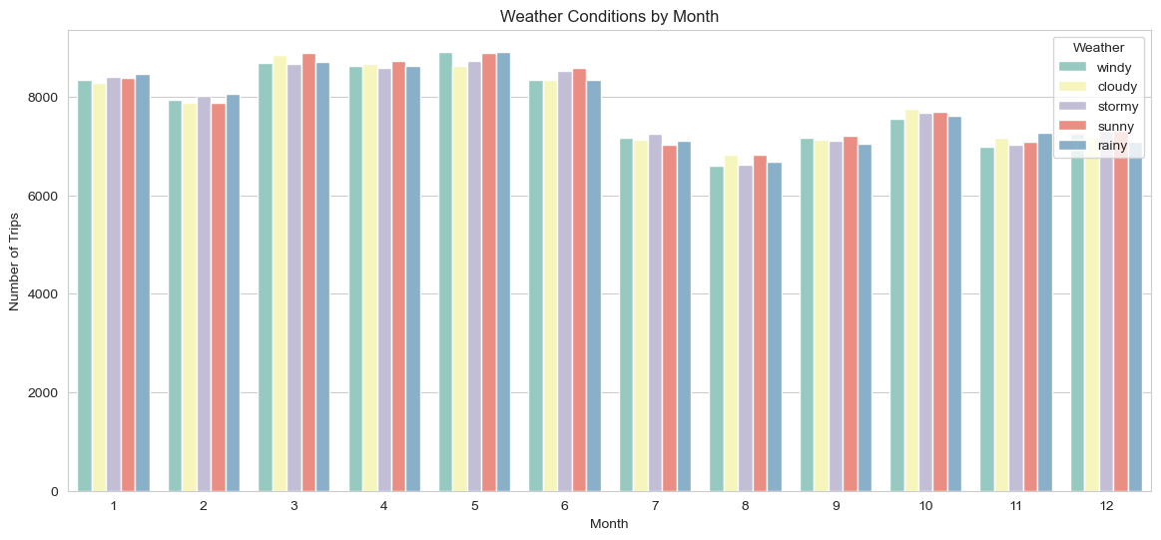
How do different weather conditions affect taxi trip frequency across months of the year?

Slide 25
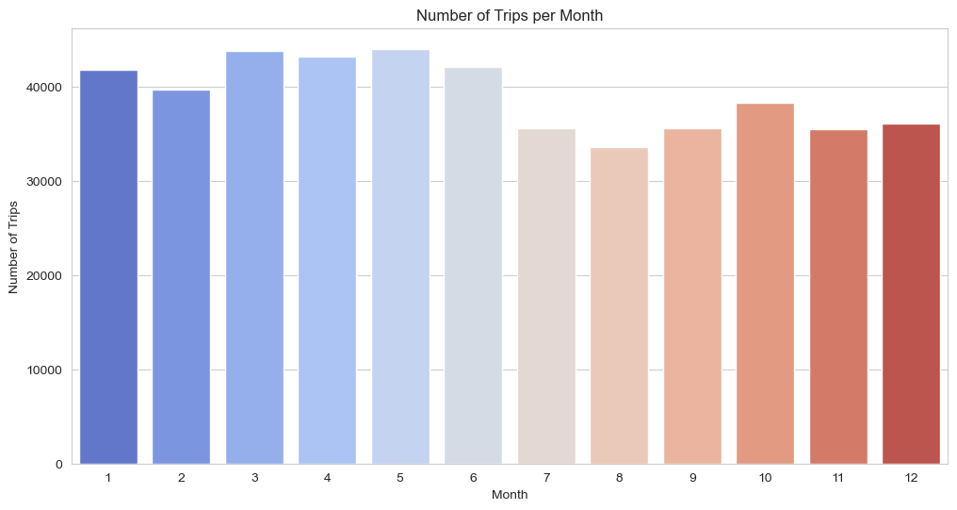
Which month recorded the highest number of taxi trips, and how does this compare to other months in terms of demand trends?

Slide 26
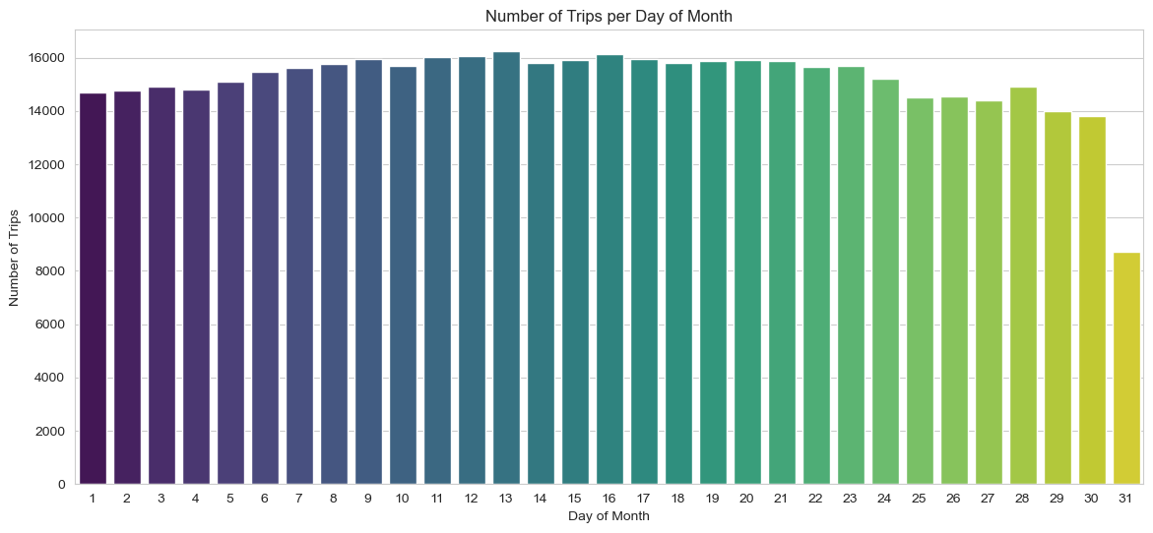
On which day of the month do taxi trips peak, and what might be the possible reasons for this surge compared to other days?

Slide 27
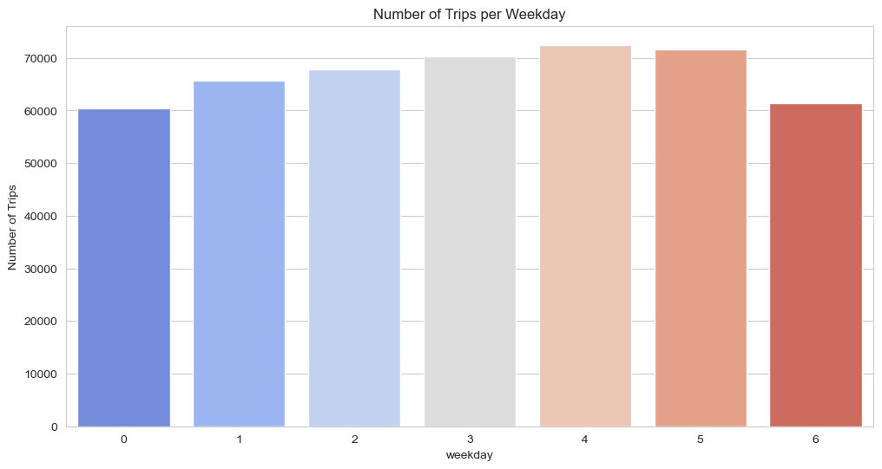
Which weekday records the highest number of taxi trips ?

Slide 28
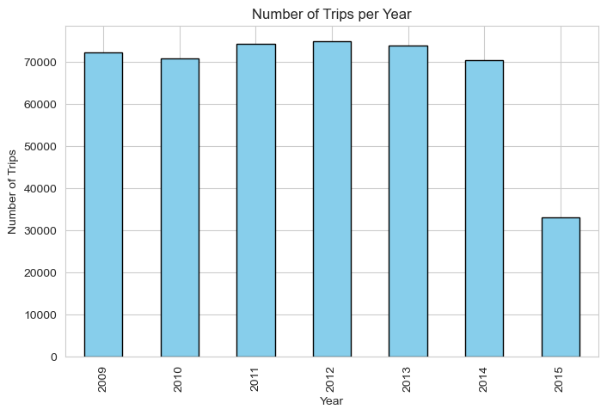
Which year recorded the highest number of trips?

Slide 29
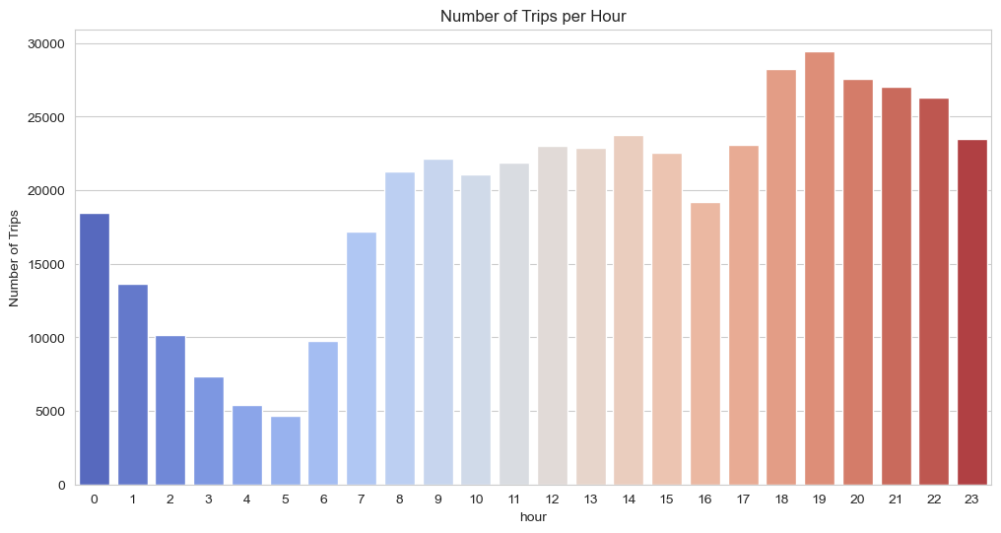
At what hour of the day do trips peak ?

Slide 30
Thank you
Abdelrahman Saad
Omar Nasser
Aya Tamer

